Slide 1


Reflective Roofing:
Concerns, Issues, Precautions & Design
Puget Sound Chapter Meeting
November 7, 2012
Seattle, Washington
presented by
Thomas W. Hutchinson, AIA, CSI, FRCI, RRC
Hutchinson Design Group, Ltd.

Slide 2
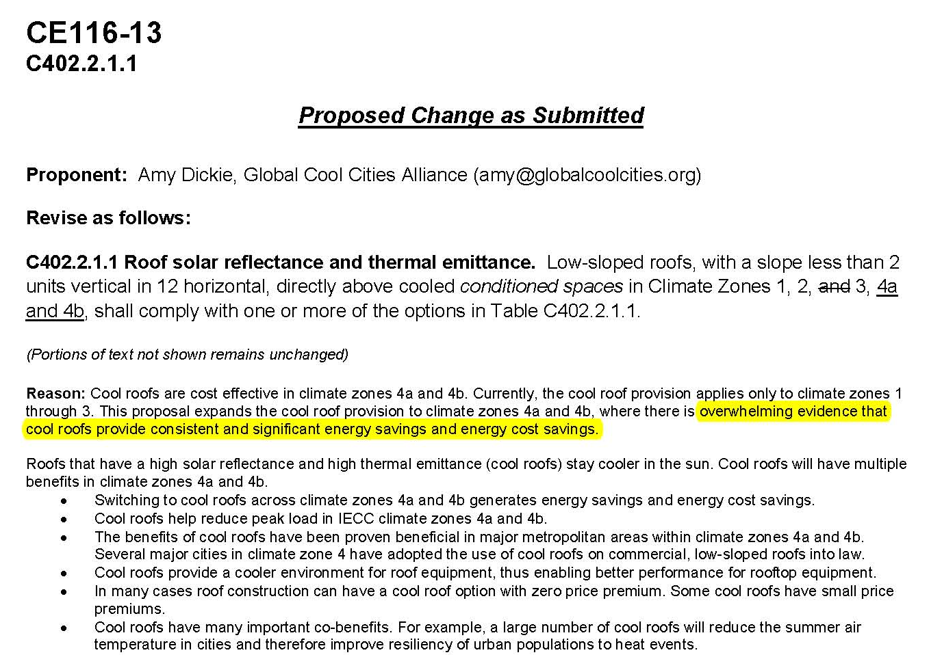
Why Are we here?

Slide 3
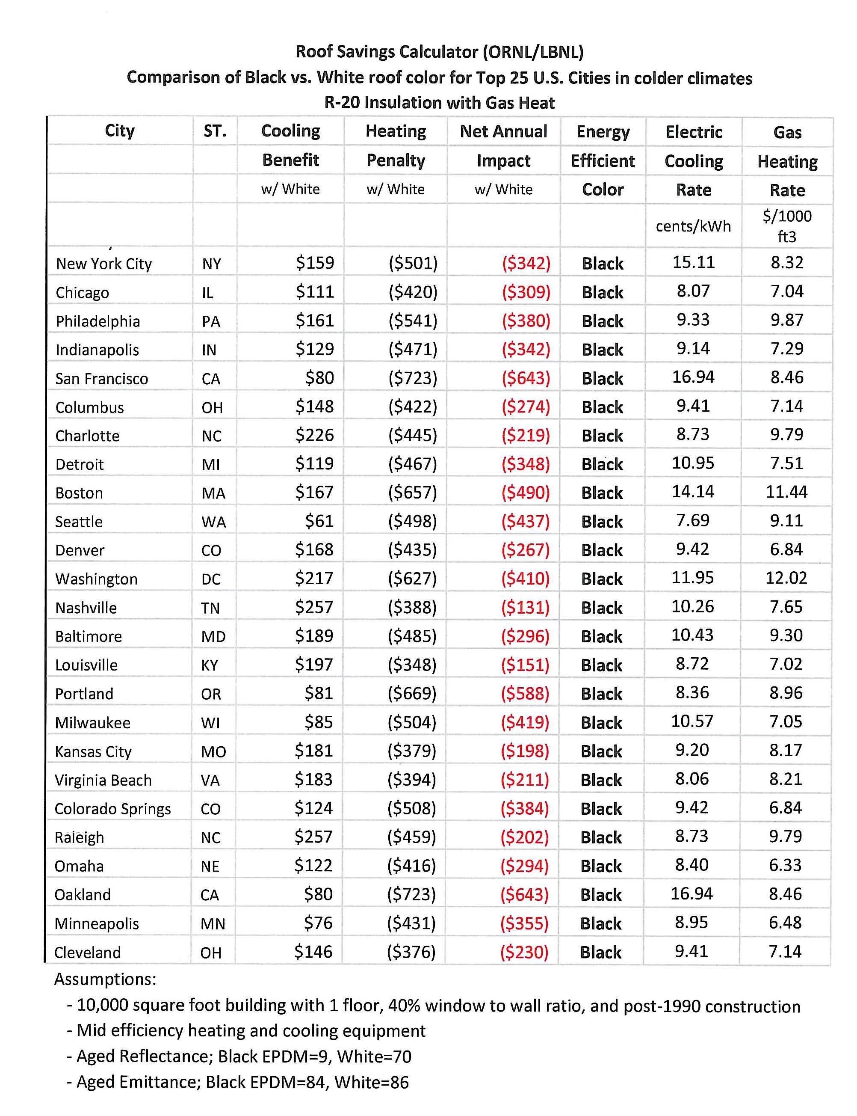
Energy Savings MYTH OR FACT!

Slide 4
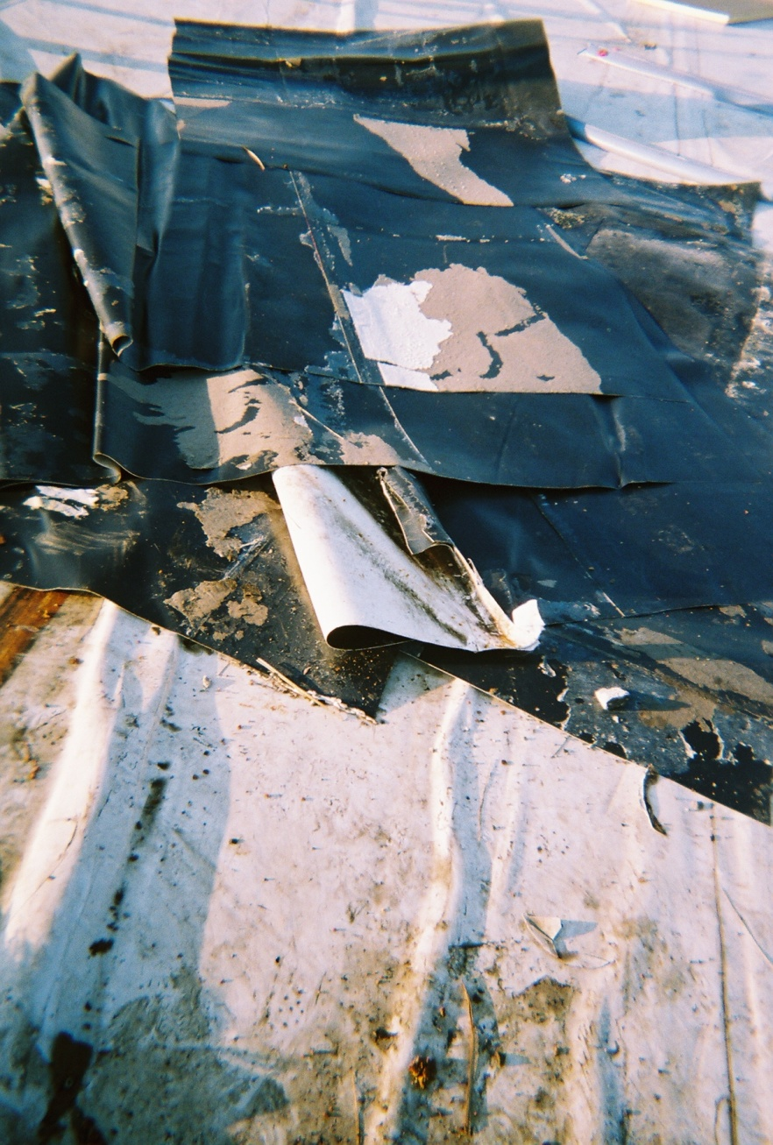
Why Are we here?

Slide 5
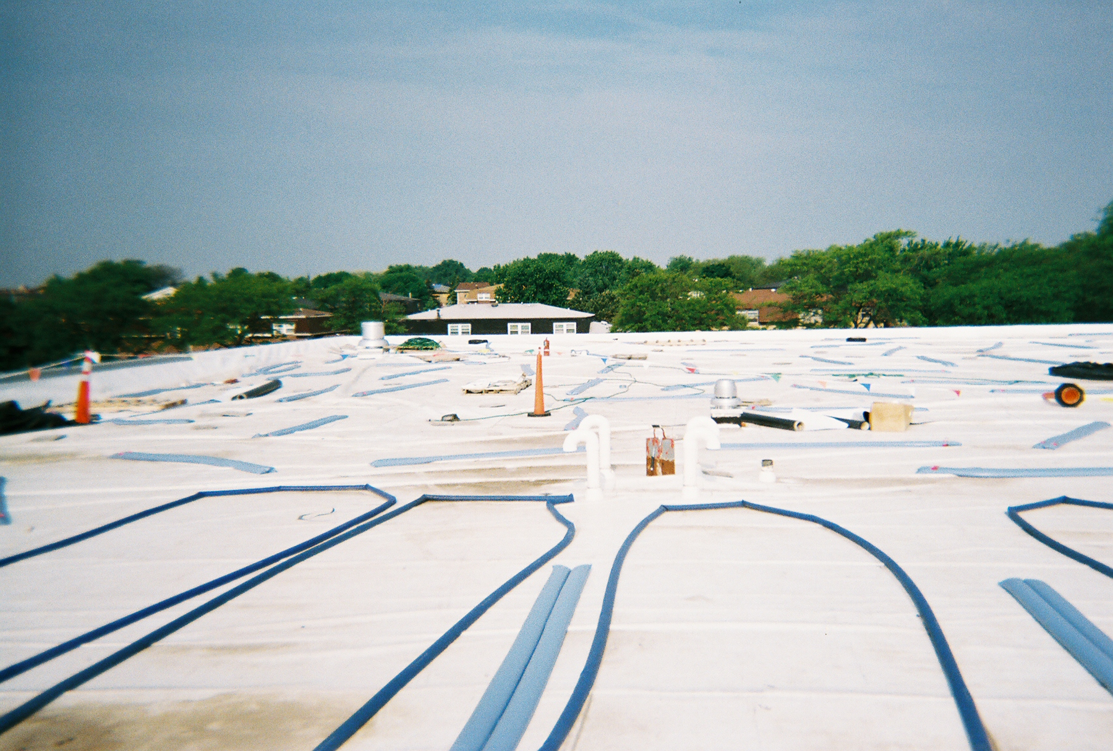
Why Are we here?

Slide 6
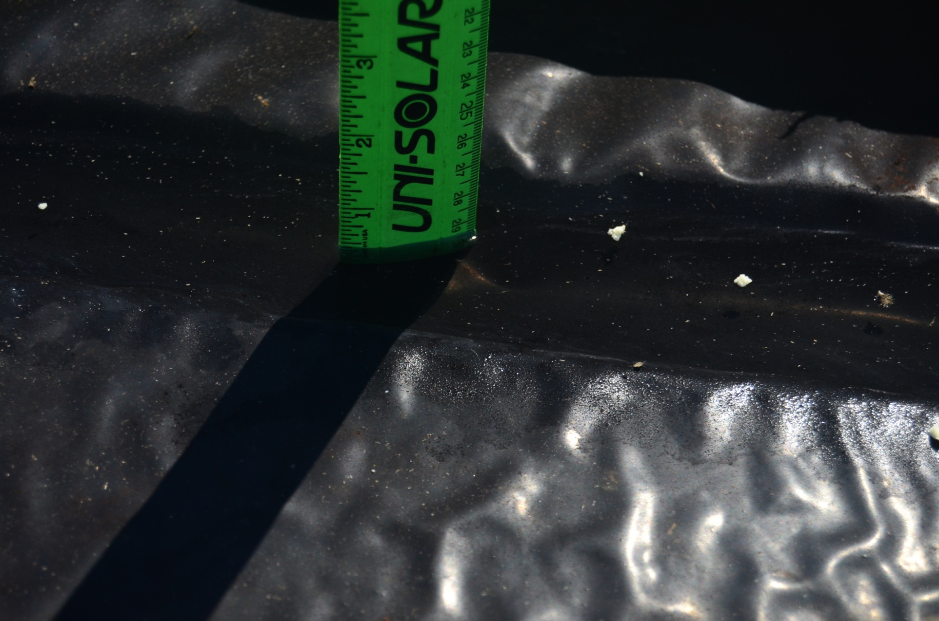
Why Are we here?

Slide 7
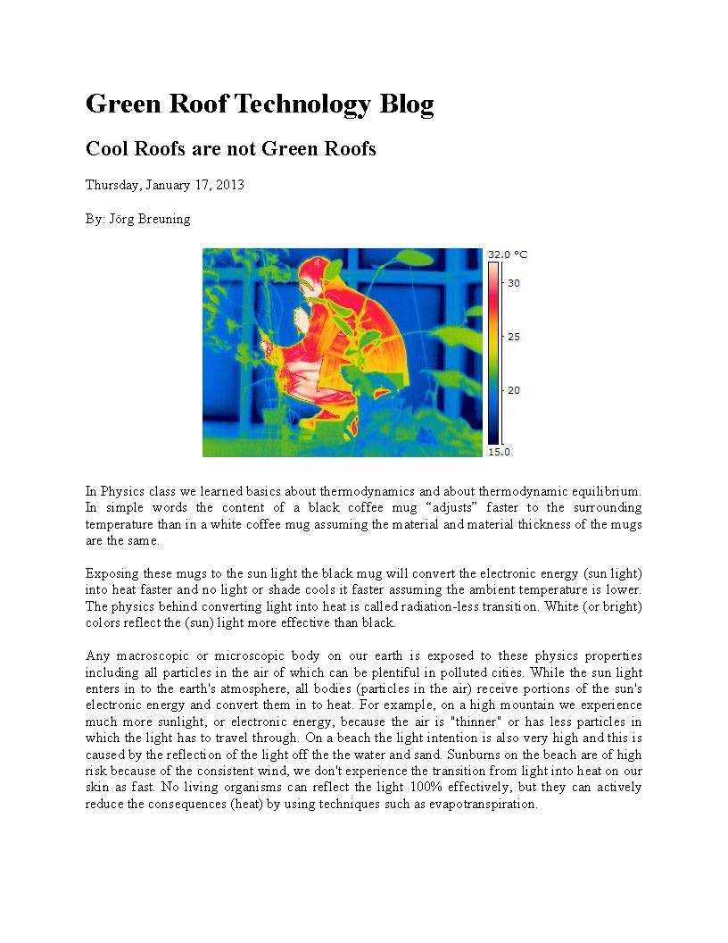
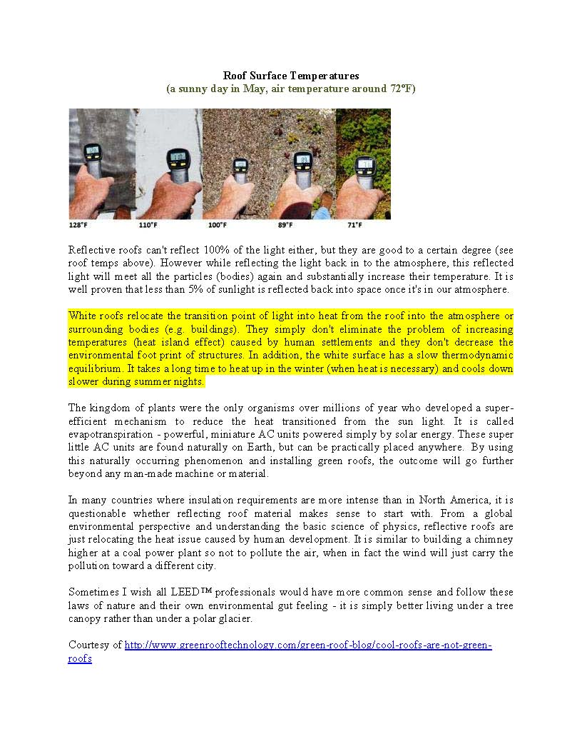
Why Are we here?

Slide 8
Why Are we here?

Slide 9
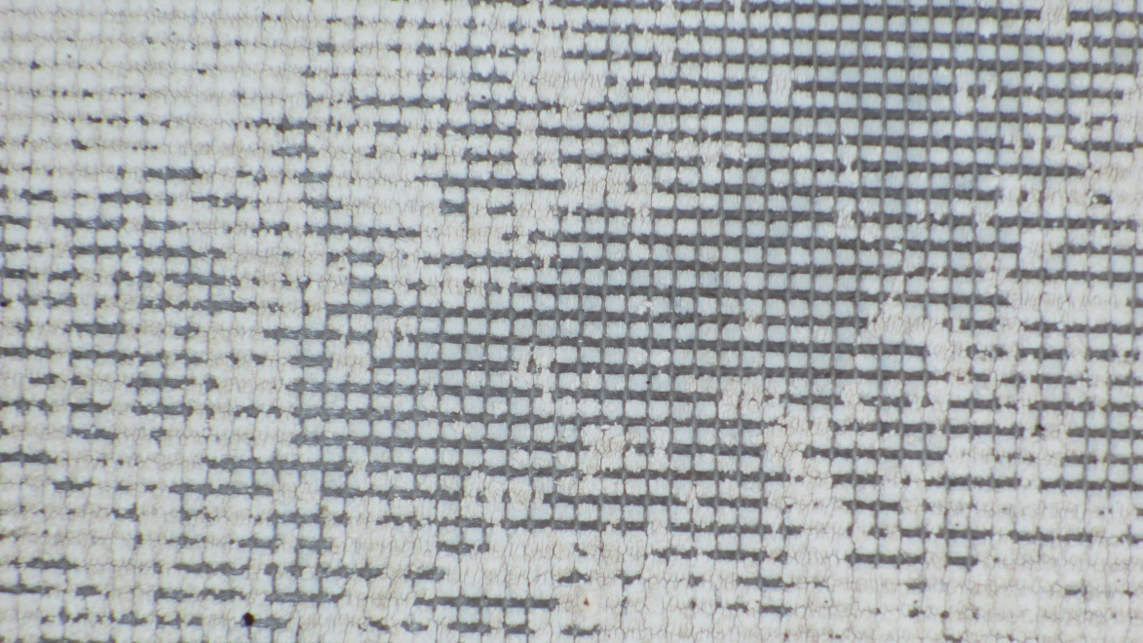

Why Are we here?

Slide 10
Presentation Quiz….
Water flows down hill?
  True
  False
  Sometimes
  Only on steep slope roofs
Roof warranties are a promise of a leak free roof?
  True
  False
FM 1A-90 is for wind coverage of 90 mph?
  True
  False
A roof material with a UL Class A rating will not burn?
  True
  False
The air over a cool roof is cooler than the air over a dark membrane roof?
  True
  False

Slide 11
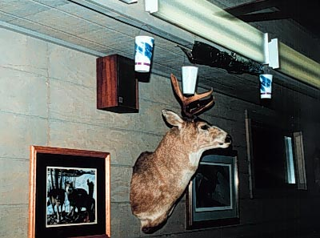
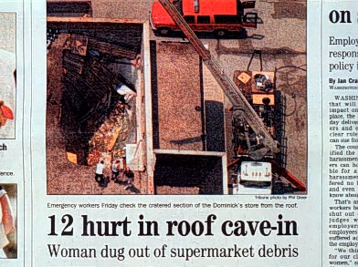
Presentation Quiz
Bonus Question:
Moisture intrusion is the #1 cause of legal concern for Architects?
  True
  False

Slide 12
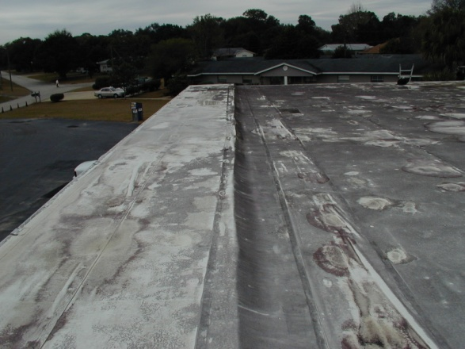
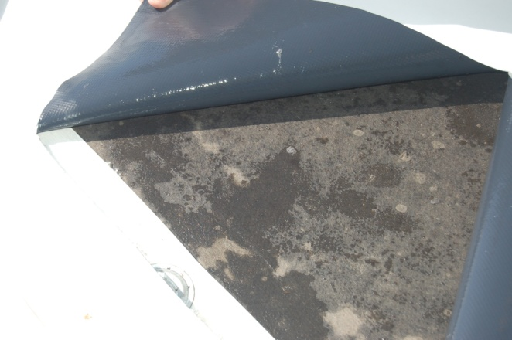
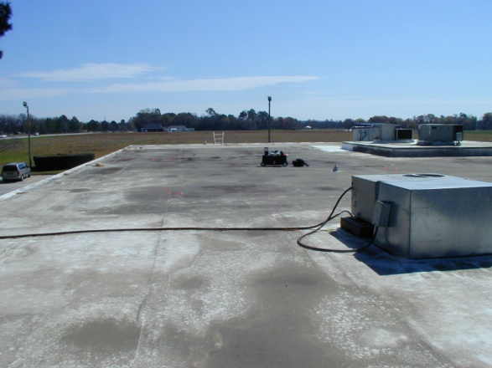
Presentation Quiz
Bonus Question:
A ‘Cool’ roof membrane will always save energy?
  True
  False

Slide 13

More than likely you said, 'A bird in the bush,'! and. ........ if this IS what YOU said, then you failed to see that the word THE is repeated twice!
Sorry, look again.

Slide 14

ALZHEIMER'S EYE TEST
Count every ' F ' in the following text:
FINISHED FILES ARE THE RE SULT OF YEARS OF SCIENTI
FIC STUDY COMBINED WITH
THE EXPERIENCE OF YEARS...

Slide 15
ALZHEIMER'S EYE TEST
Count every ' F ' in the following text:
FINISHED FILES ARE THE RE SULT OF YEARS OF SCIENTI
FIC STUDY COMBINED WITH
THE EXPERIENCE OF YEARS...
HOW MANY ?
WRONG, THERE ARE 6 -- no joke.
READ IT AGAIN !
.
The reasoning behind is further down.
The brain cannot process 'OF'.
Notes:
1/10/2014 8:42:10 AM
CAC-RCI - Jan 14, 2008
15

Slide 16
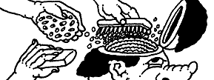
More Brain Stuff . .
From Cambridge University ...
Olny srmat poelpe can raed tihs.
I cdnuolt blveiee taht I cluod aulaclty uesdnatnrd waht I was rdanieg.. The phaonmneal pweor of the hmuan mnid, aoccdrnig to a rscheearch at Cmabrigde Uinervtisy, it deosn't mttaer in waht oredr the ltteers in a wrod are, the olny iprmoatnt tihng is taht the frist and lsat ltteer be in the rghit pclae. The rset can be a taotl mses and you can sitll raed it wouthit a porbelm. Tihs is bcuseae the huamn mnid deos not raed ervey lteter by istlef, but the wrod as a wlohe. Amzanig huh? yaeh and I awlyas tghuhot slpeling was ipmorantt! if you can raed tihs psas it on!!

Slide 17
Photos of Performing Cool Roofs
TPO
Modified Bitumen
Ballasted
EPDM

Slide 18
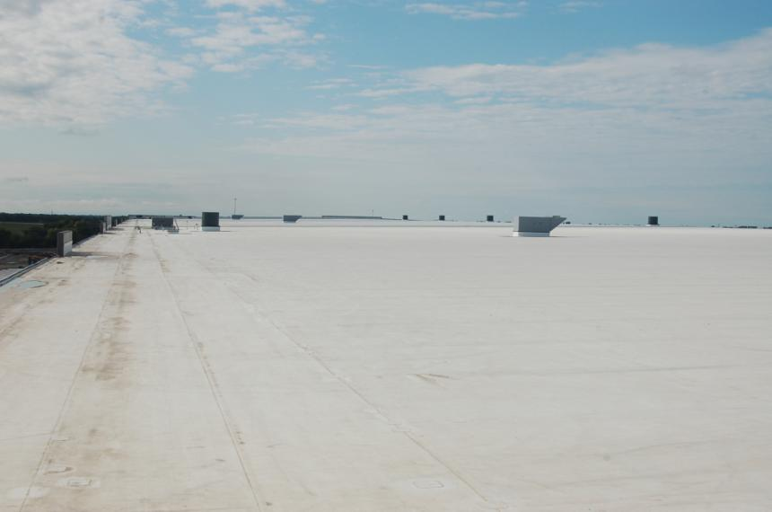
Performing Cool Roofs
TPO

Slide 19
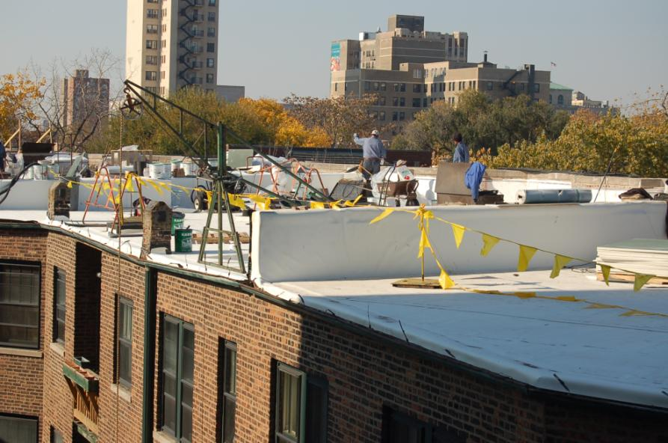
Performing Cool Roofs
TPO

Slide 20
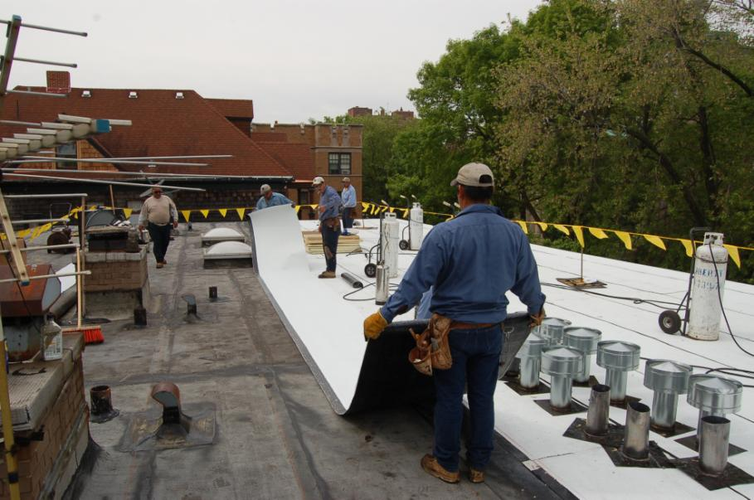
Performing Cool Roofs
Modified Bitumen

Slide 21
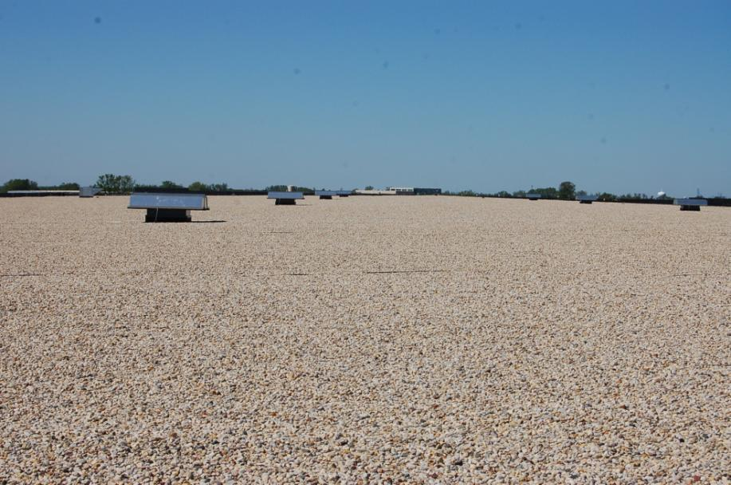
Performing Cool Roofs
Ballasted

Slide 22
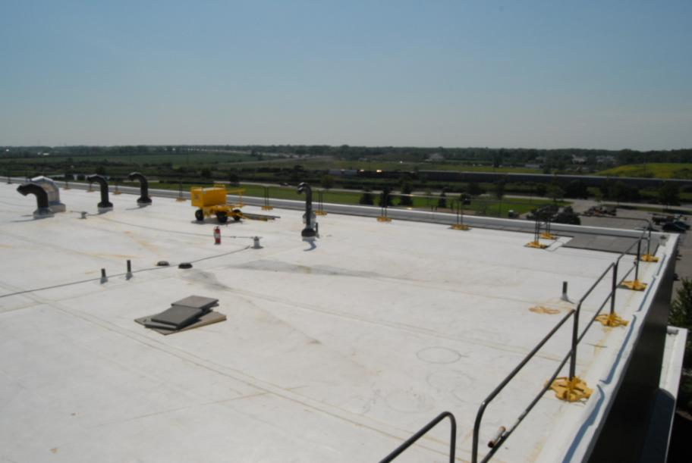
Performing Cool Roofs
EPDM

Slide 23
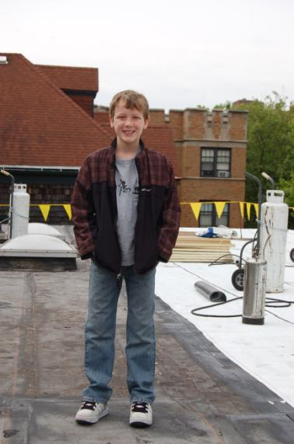
Performing Cool Roofs
Qualified Roof Inspector
Modified Bitumen

Slide 24
non-Performing Cool Roofs
TPO
Modified Bitumen

Slide 25
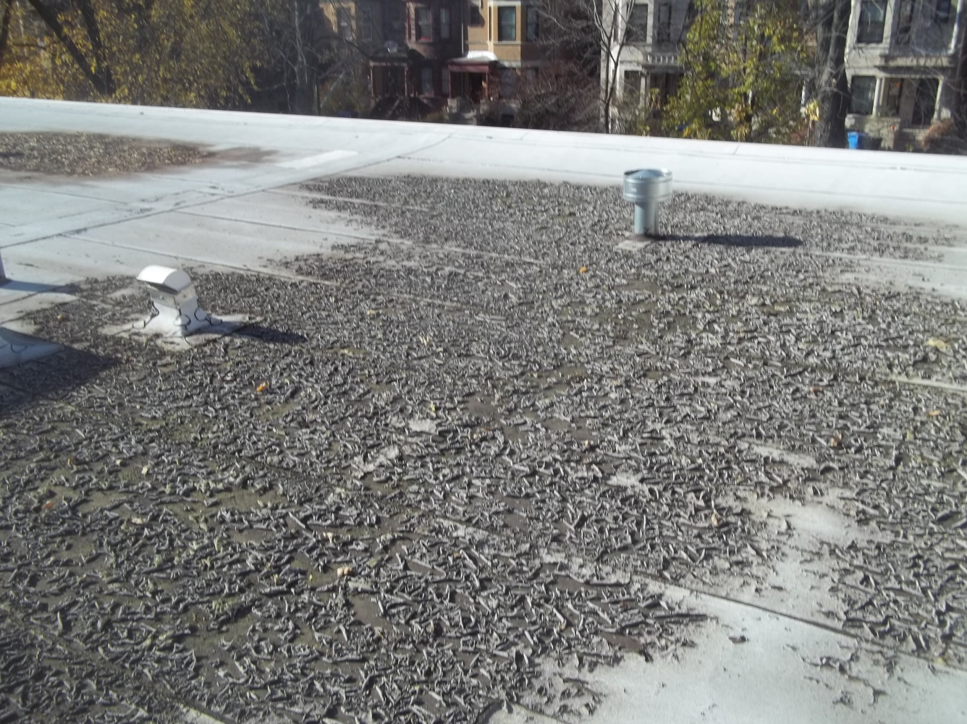
non-Performing Cool Roofs
Modified Bitumen

Slide 26
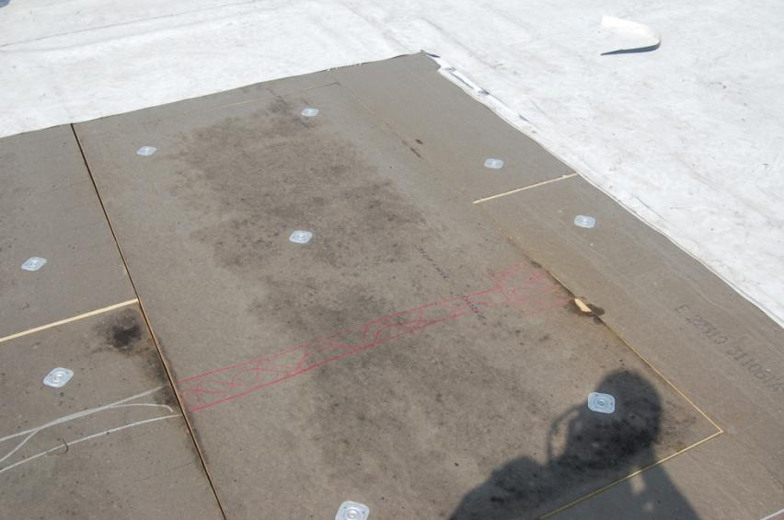
non-Performing Cool Roofs
TPO

Slide 27
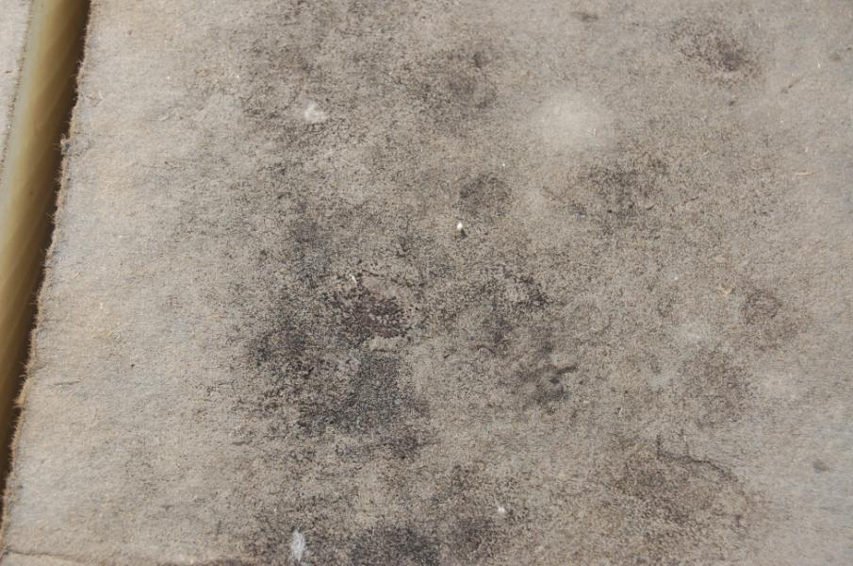
non-Performing Cool Roofs
TPO

Slide 28
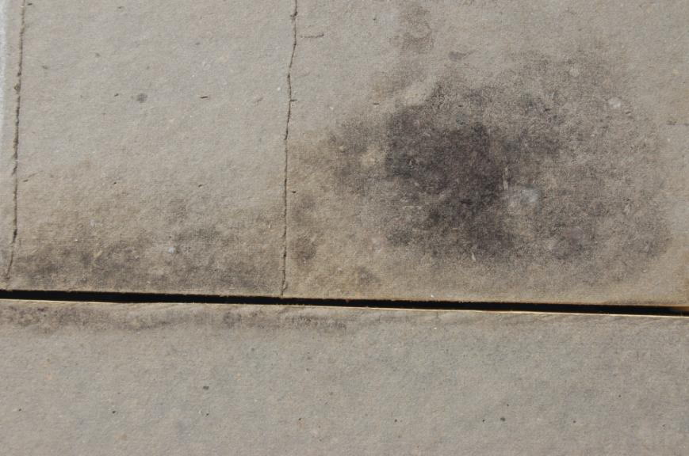
non-Performing Cool Roofs
TPO

Slide 29
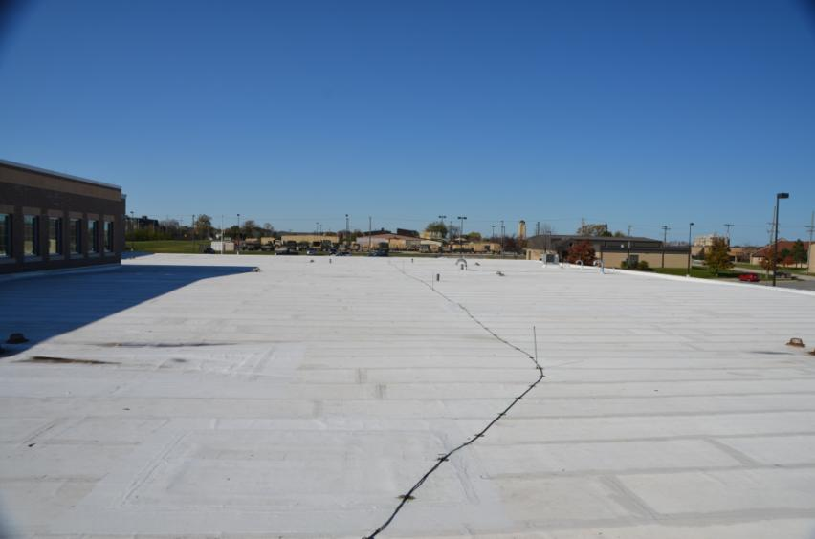
non-Performing Cool Roofs
Modified Bitumen

Slide 30
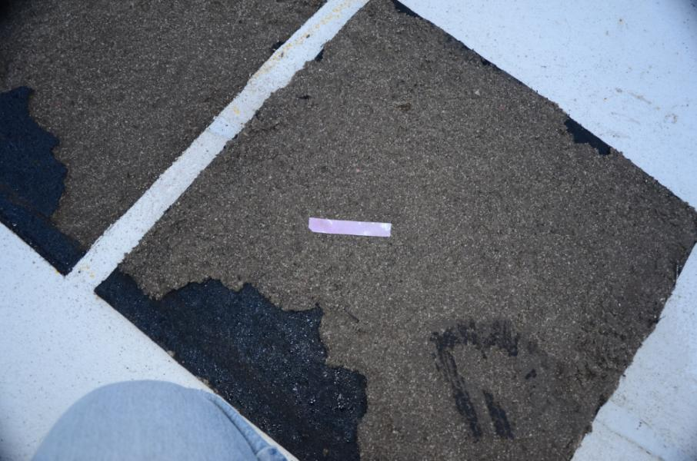
non-Performing Cool Roofs
Modified Bitumen

Slide 31
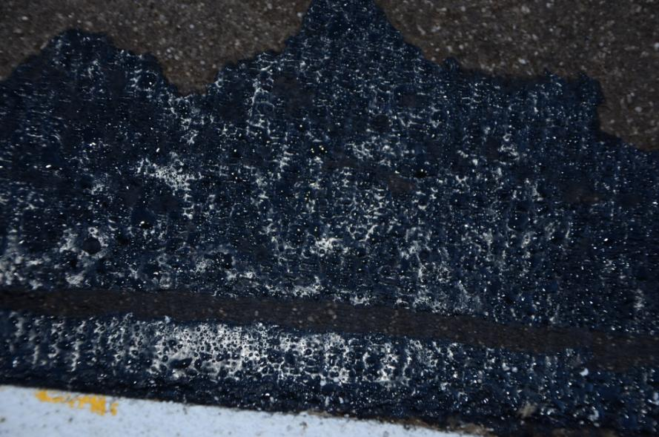
non-Performing Cool Roofs
Modified Bitumen

Slide 32
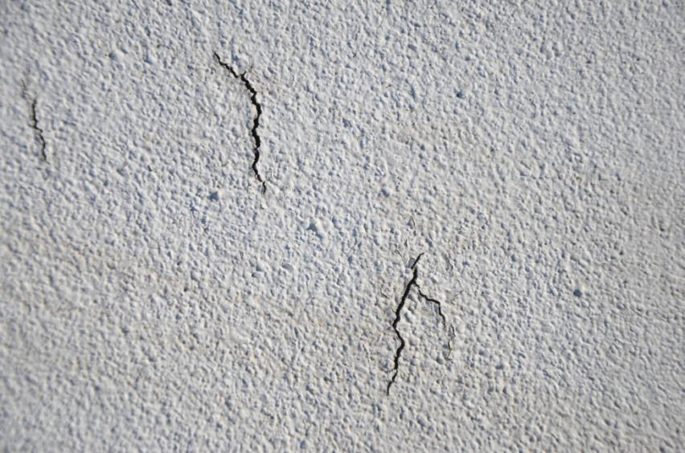
non-Performing Cool Roofs
Modified Bitumen

Slide 33
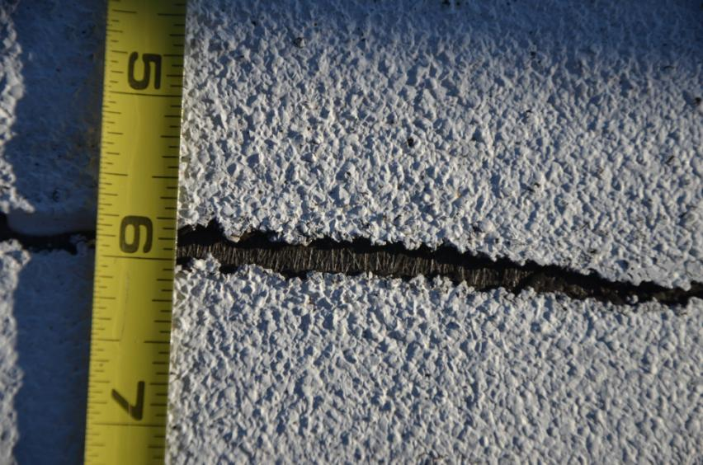
non-Performing Cool Roofs
Modified Bitumen

Slide 34
Today’s Goals
Understand the importance of DESIGN in ‘Cool Roof Systems’
Grasp the importance of understanding and controlling air movement in the success of roof system design
Understanding that air flow into cool roof systems can be detrimental to their long term performance
DESIGN

Slide 35
Today’s Goals
Learn that buildings have life cycles and that interior moisture levels and air flow into roofing systems will vary
Acknowledge that ‘unintended’ consequences can and will shorten service life
Realize roofs are systems, and as such can NOT be designed as a single component

Slide 36
Today’s Goals
Assist you in the success of your cool roof system design
Realize that you, as designer, and not the proponents of cool roofs, have responsibility if failure results
That as a ‘Designer’ you are responsible for keeping the water above the top of your roof membrane

Slide 37

GLOBAL WARMING MYTH OR FACT!

Slide 38

GLOBAL WARMING MYTH OR FACT!

Slide 39
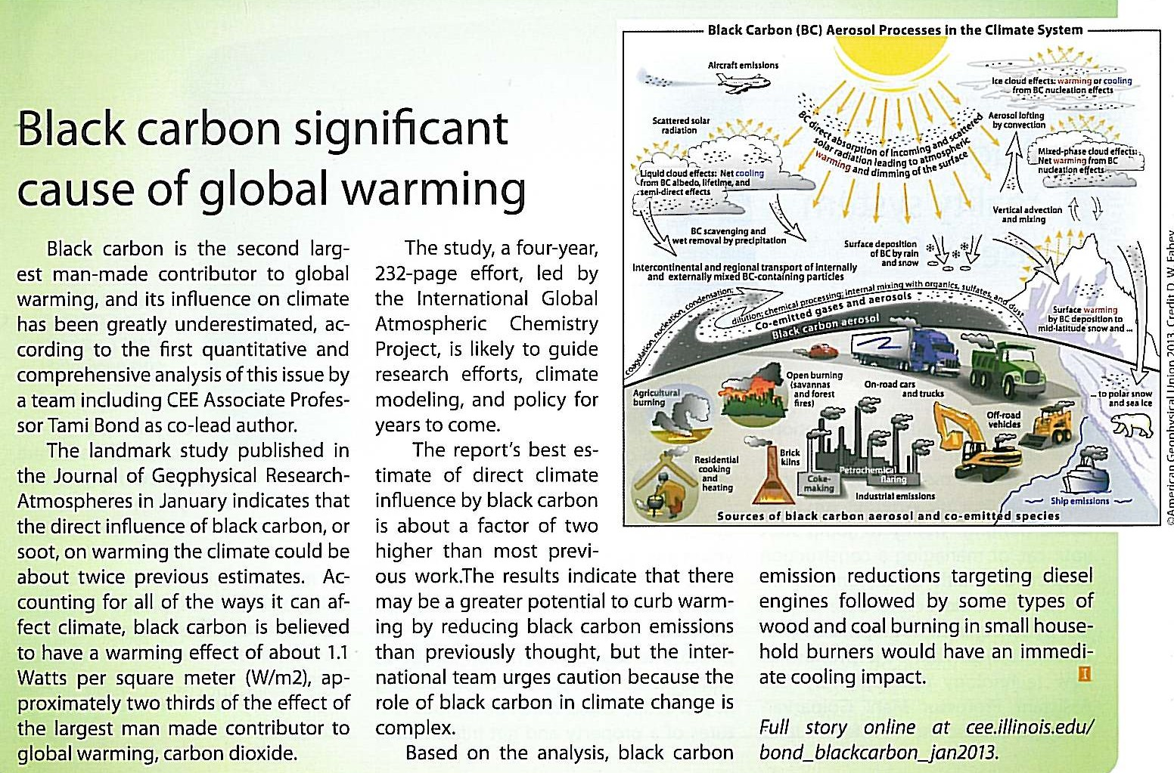
GLOBAL WARMING MYTH OR FACT!

Slide 40
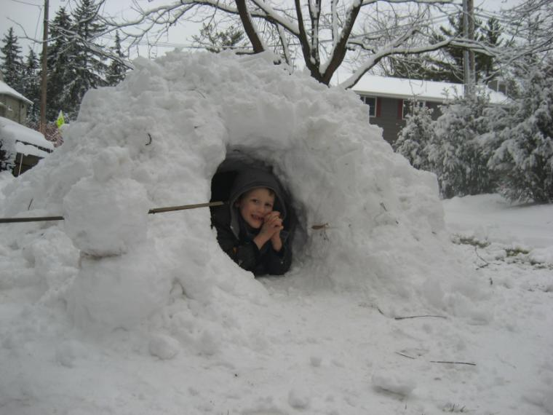
Perfect Cool Roof?
Maybe Not!

Slide 41
History
LEED promotes under auspices of:
  Potential energy savings
  Urban heat island
    Based on publications by LBL
      Pseudo science?
News Flash
“White Roofs Increase Urban Heat Island Effect”

Slide 42
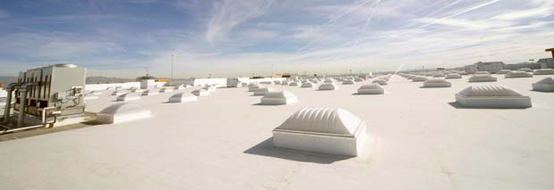
News Flash
"There does not seem to be a benefit from investing in white roofs," says Jacobson. "The most important thing is to reduce emissions of the pollutants that contribute to global warming.“
- Mark Jacobson, a professor of civil and environmental engineering at Stanford

Slide 43
Sustainable Fact
Appropriate design and use of materials within a roof system is required to achieve long-term service life

Slide 44
Long-term Performance
=
Sustainability
30+ Years

Slide 45
Long-Term Performance
Ballasted Roof 30 years old

Slide 46
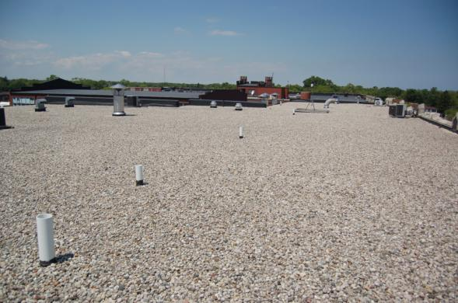
Sustainability is about long-term Service Life
Waukegan Public SD 60 - Waukegan, IL - 1986

Slide 47
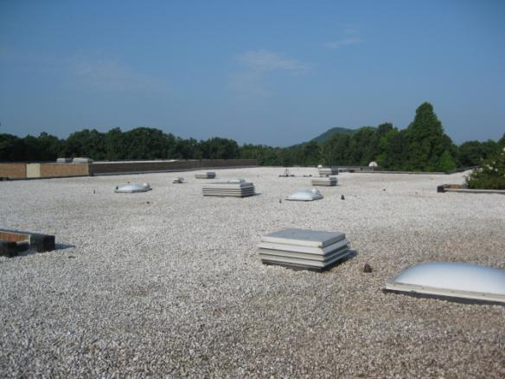
Sustainability is about long-term Service Life
North Ashboro Middle School, Ashboro, NC

Slide 48
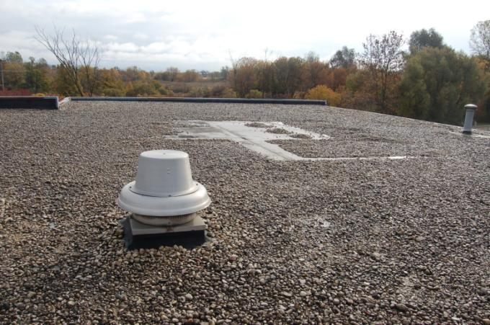
Sustainability is about long-term Service Life
Firestone’s first EPDM roof, 31 years and still going

Slide 49
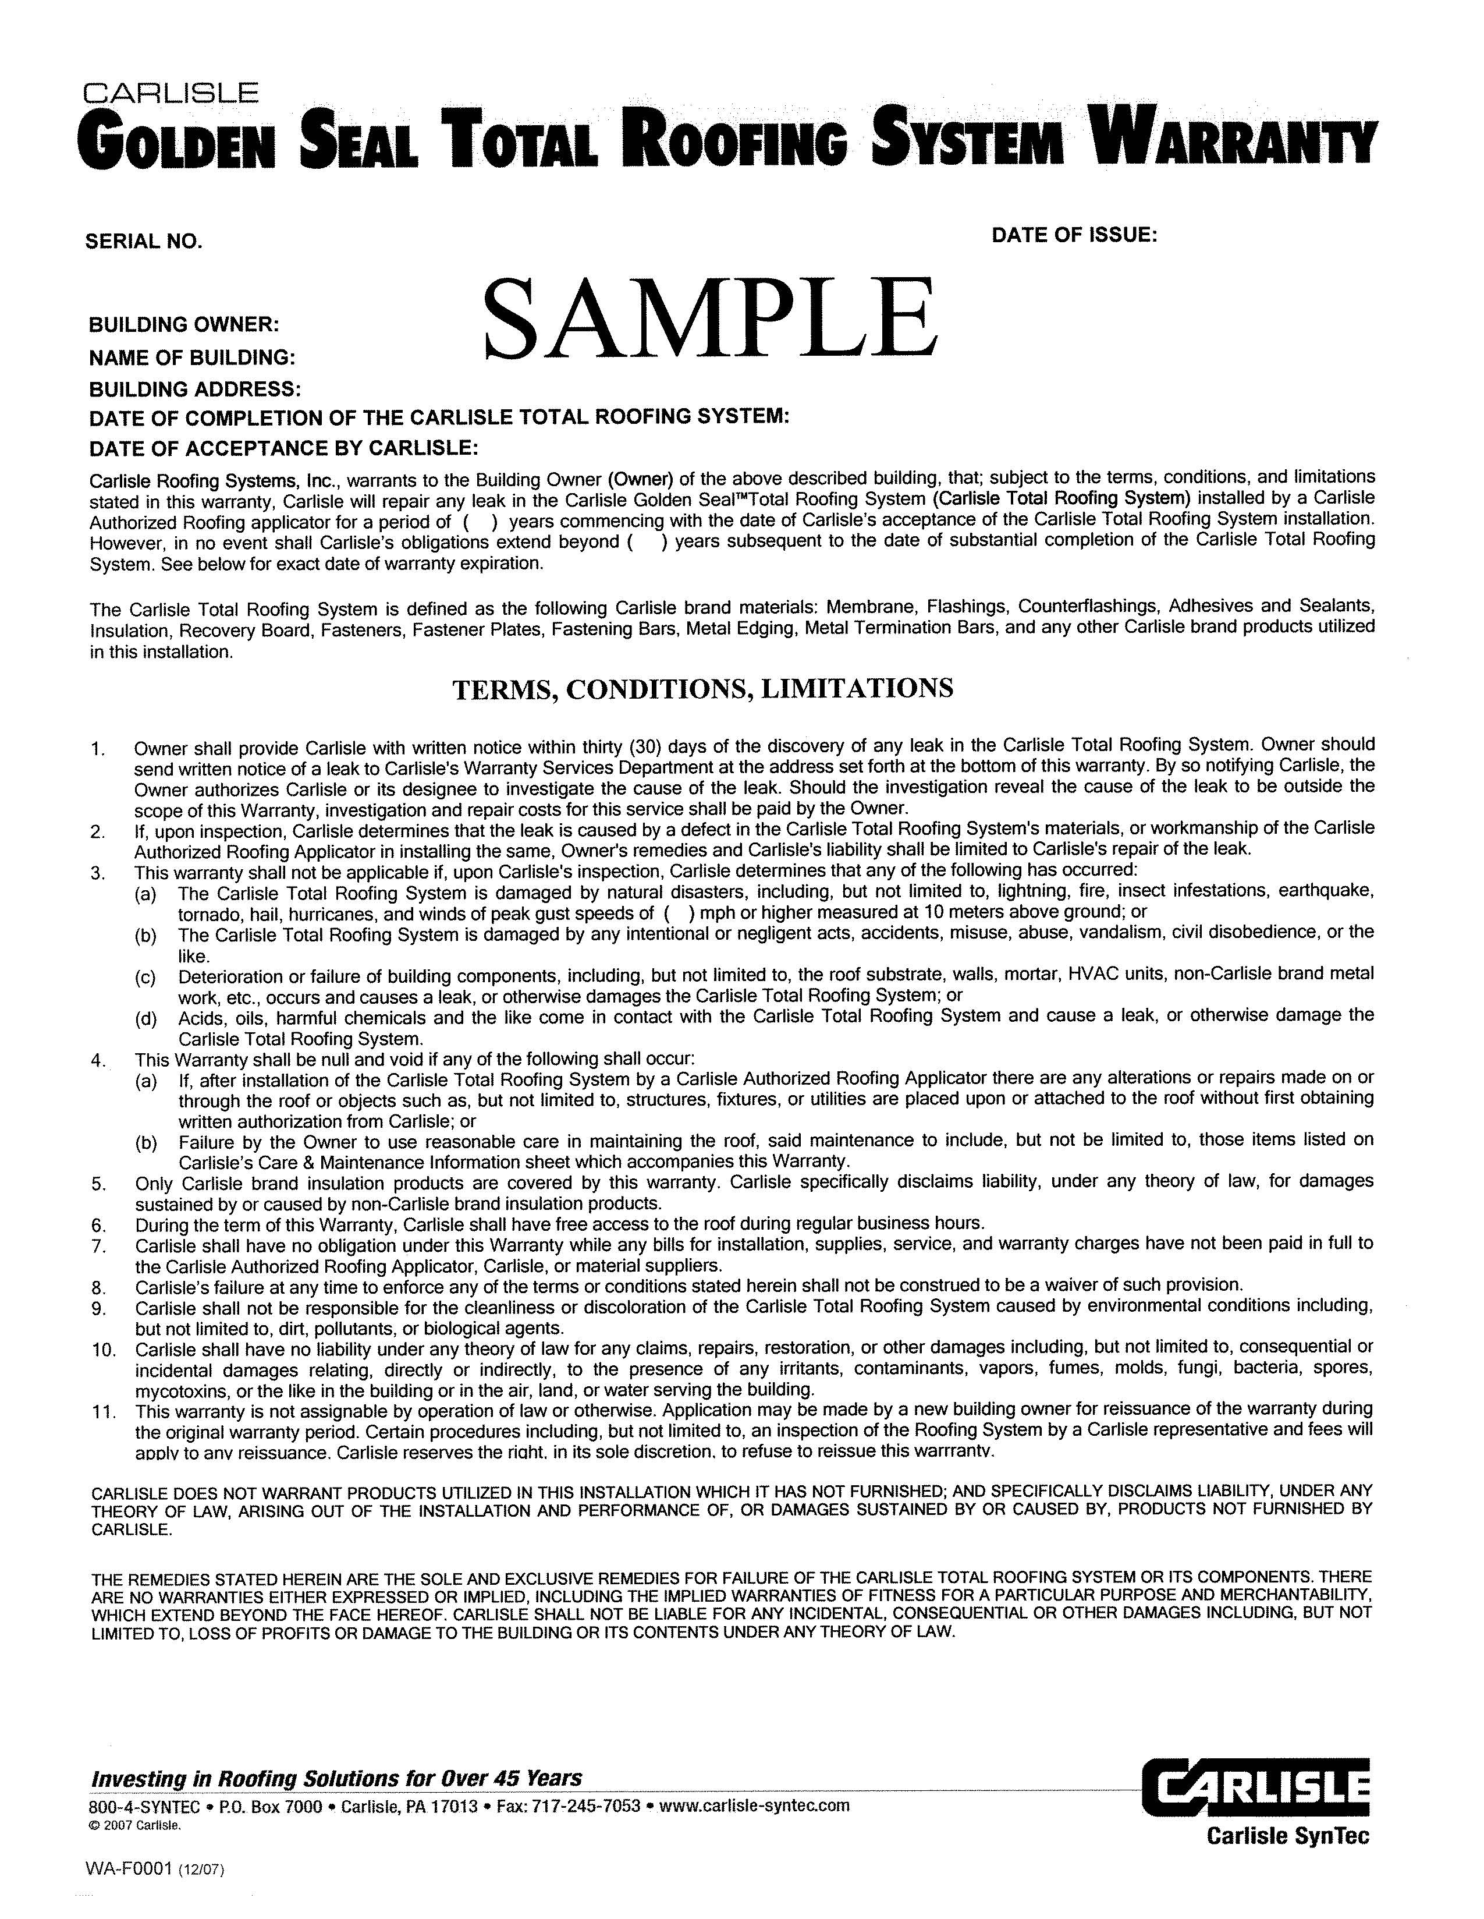

Slide 50
Warranty
Covers leaks

Slide 51
Warranty
Not condensation

Slide 52
The Concern
The cool(er) surface temperature of ‘cool’ membranes results in dew points being reach much sooner than darker membranes and does not provide for a downward moisture drive. Thus the potential for a ‘self drying roof system is lost.

Slide 53
Learning from Experience
Empirical Evidence of Concern
  Concerns began to arise ±2006
  Mysterious interior moisture
    Dripping on sunny days
      No apparent ponding
      No roof surface deficiencies

Slide 54
Learning from Experience
Cool roof tragedies
  Chicago and Environs - $15,000,000 in reconstruction of cool roof systems less then 3 years old
  A travesty if you’re an owner
  Remember those proponents
  . . . they paid zip, zero, not-a, nothing
  . . . not even a “sorry”

Slide 55



Slide 56
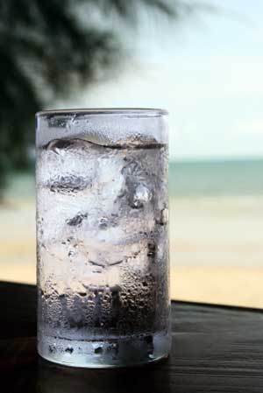

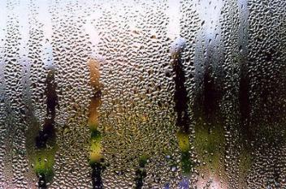
Learning from Experience
Physics
Condensation

Slide 57
Learning from Experience
Roofing 101 – Quiz Question
  What is the most deleterious element within a roof system?
  . . . water

Slide 58
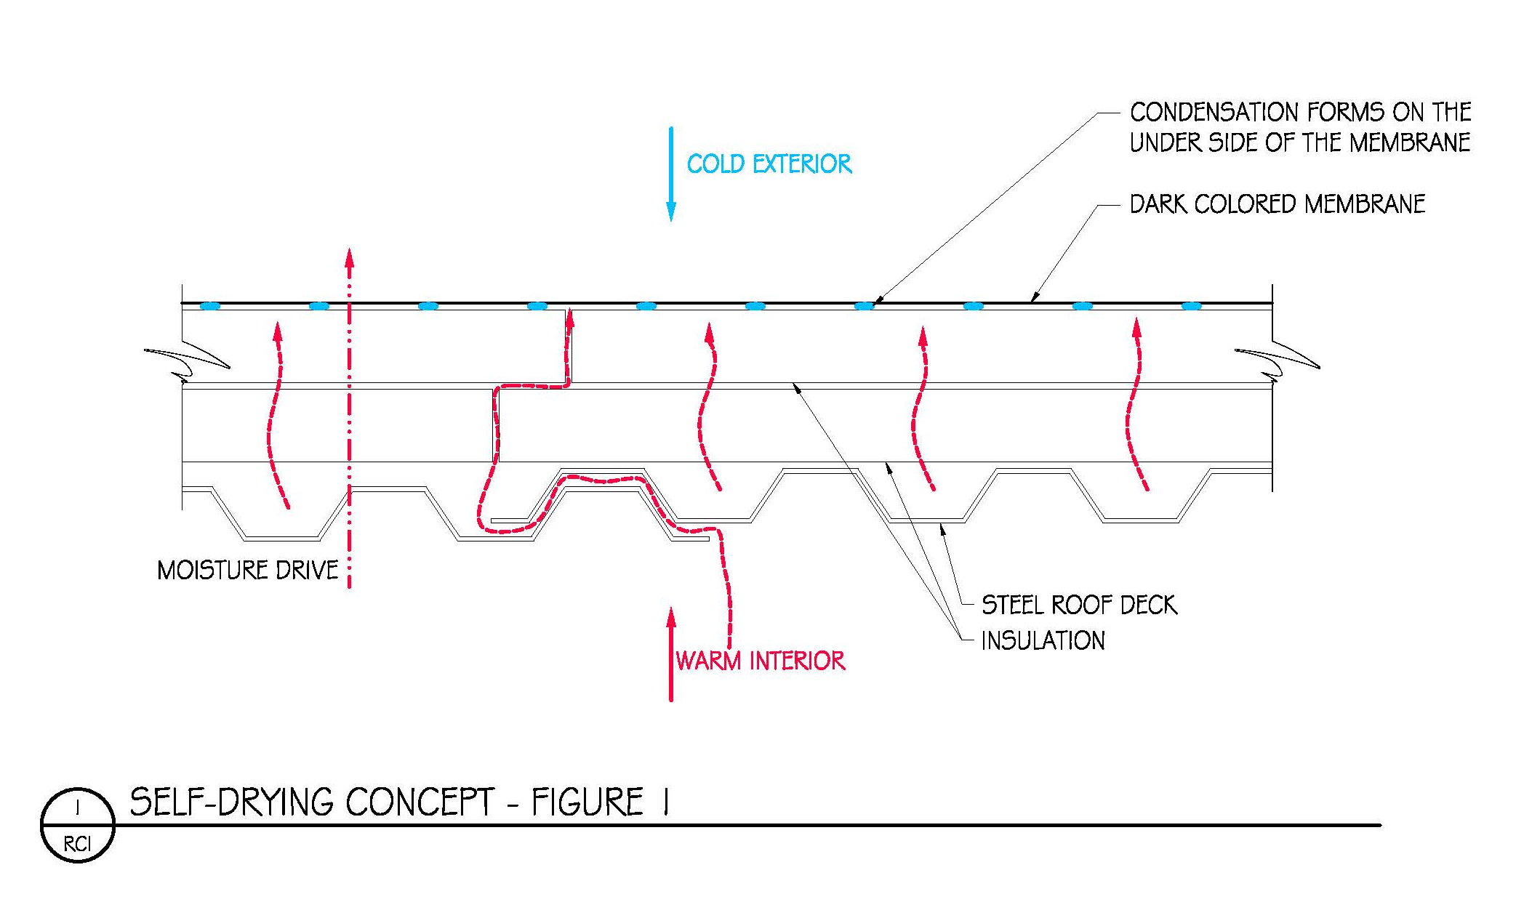
Self Drying Roof Concept

Slide 59
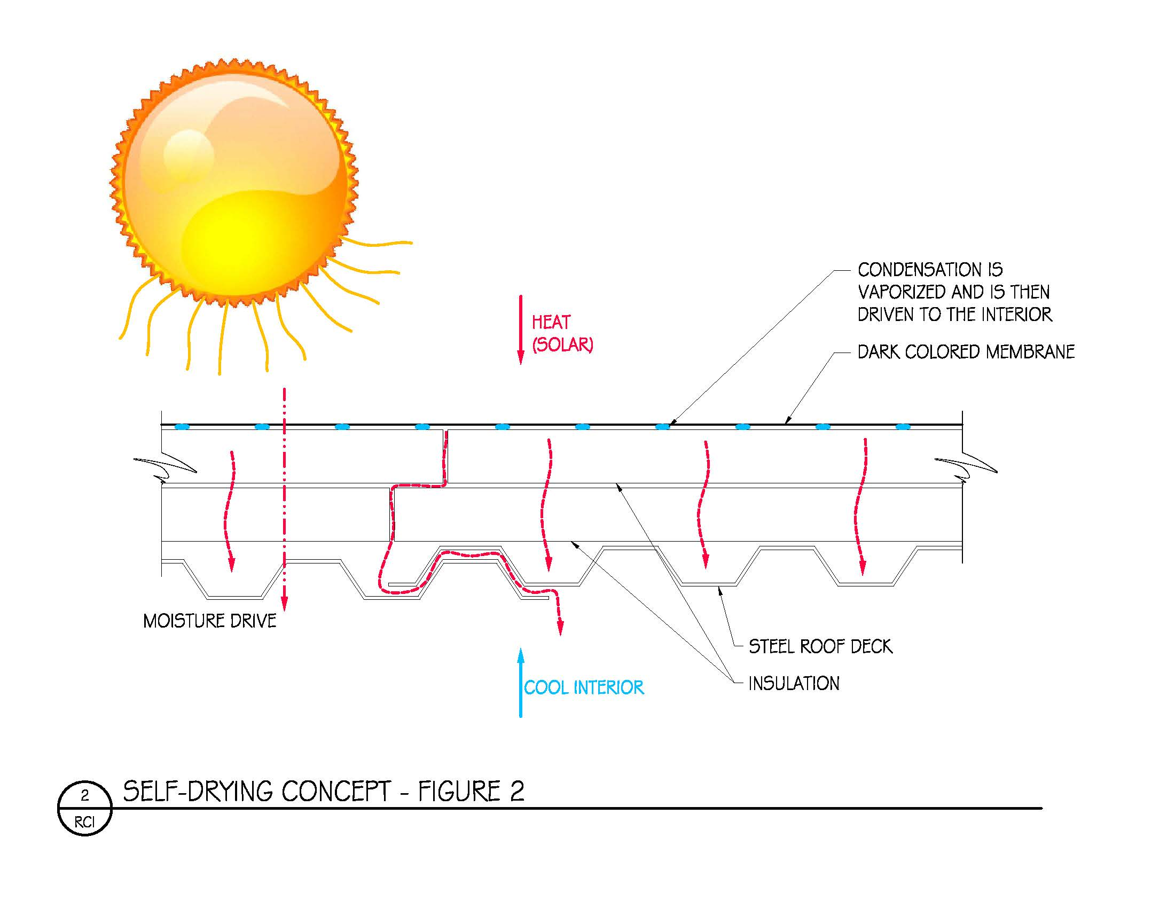
Self Drying Roof Concept

Slide 60
Learning from Experience
Condensation
  Don’t create it!

Slide 61
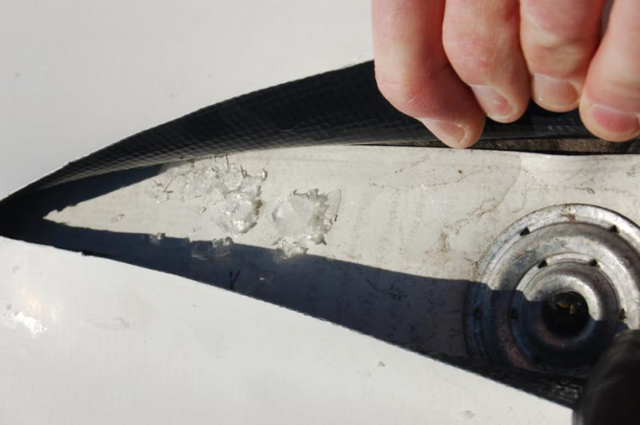
Condensation
Notes:
61

Slide 62
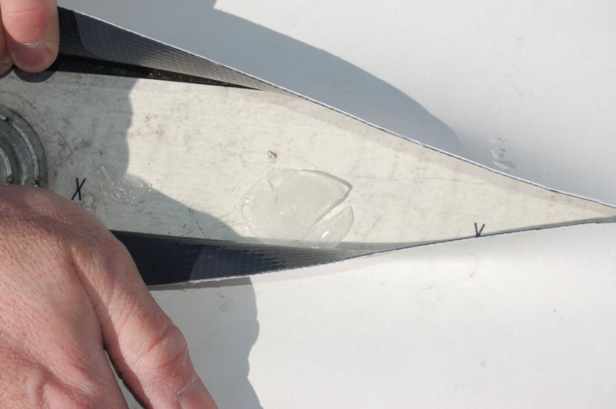
Condensation
Notes:
CAC-RCI - Jan 14, 2008
62

Slide 63
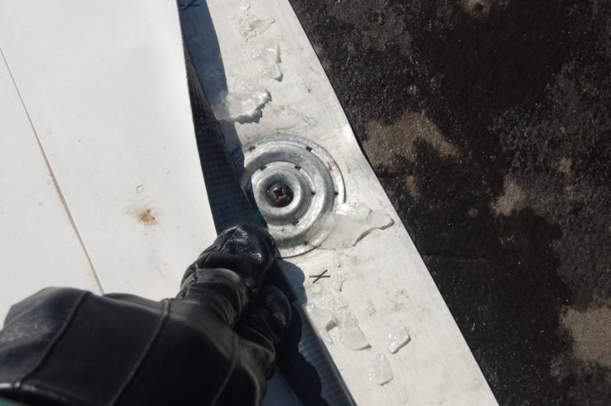
Condensation
Notes:
CAC-RCI - Jan 14, 2008
63

Slide 64
Air Flow: Interior to Exterior Means
Diffusion
Leakage
Positive Pressure
Pressure Gradient
  Energy High to Energy Low

Slide 65
Learning from Experience
Empirical Evidence of Concern
  Building sealant joints (above cool roofs) experience accelerated deterioration

Slide 66
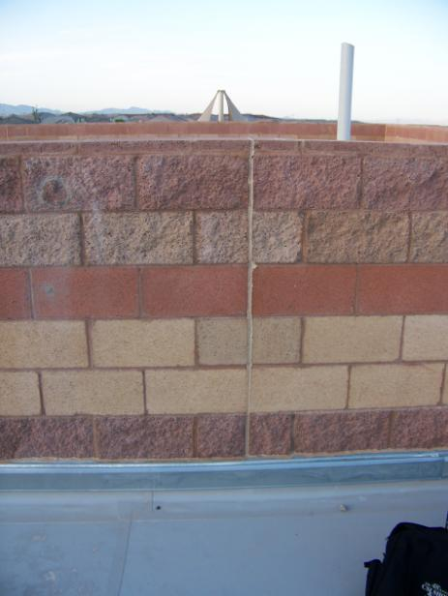
Learning from Experience

Slide 67
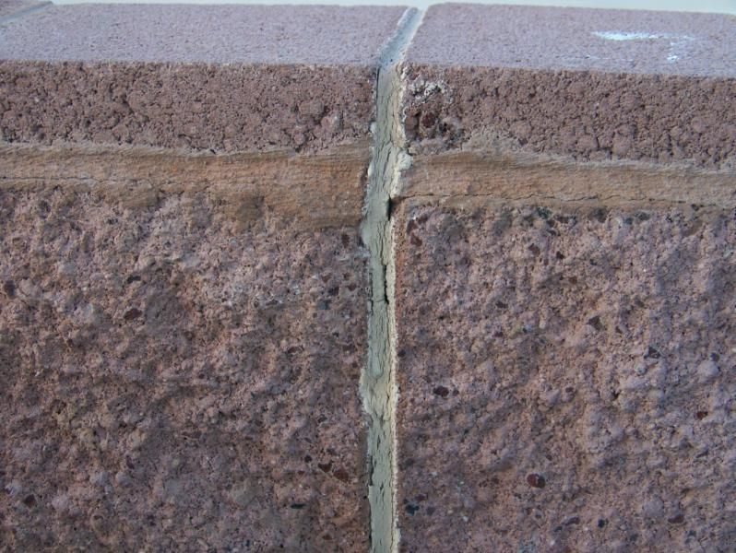
Learning from Experience

Slide 68
Learning from Experience
Empirical Evidence of Concern
  Masonry walls (above cool roofs) experience excessive expansion, resulting in over-compressed masonry control sealant joints, reflection into glass windows, and overheating

Slide 69
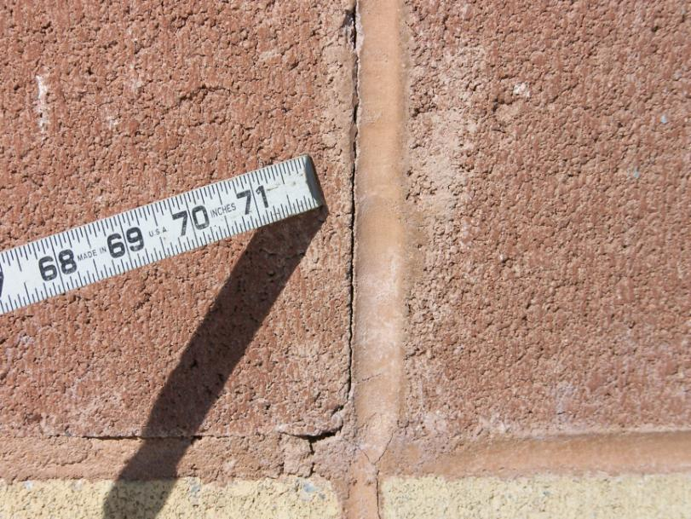
Learning from Experience

Slide 70
Learning from Experience
Empirical Evidence of Concern
  Roof-to-wall base flashings prematurely deteriorating due to excessive heat aging
  Membrane at high parapet walls, high base flashing prematurely deteriorating due to excessive heat aging

Slide 71
Learning from Experience
Empirical Evidence of Concern
  Low slope roof reflection on adjacent and/or nearby structures a concern

Slide 72
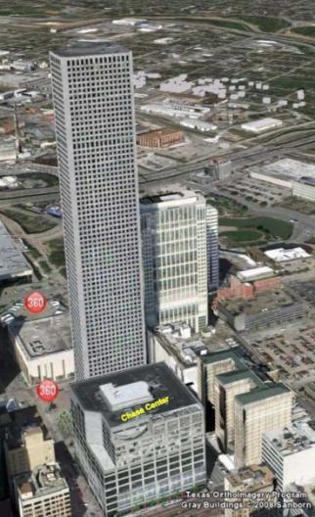
Roof System Design Considerations
View of Chase Center on East side of Chase Tower

Slide 73
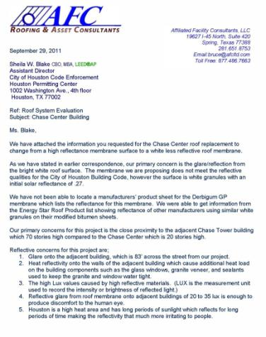
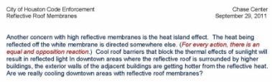
Roof System Design Considerations

Slide 74
Learning from Experience
Empirical Evidence of Concern
  Rooftop mechanical equipment operating with increased inefficiency
    Below promised results

Slide 75
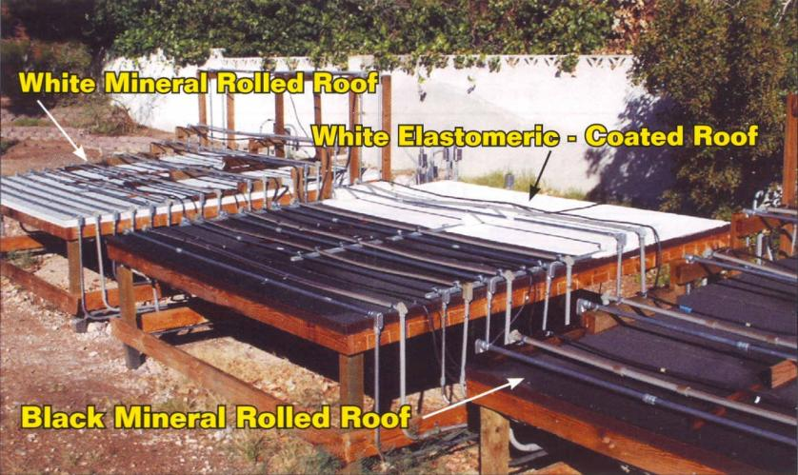
Roof surface cover range of reflectivity from very white to black

Slide 76

Temperature rise as a function of roof color

Slide 77



CCM Air Temperature Study - 2011
July 7 thru Aug 16 – Carlisle, PA
Temperature Recorded at ;
(0”) - 10” - 16” - 22” - 34”
Data Recorded: 9:00 AM -12:00 PM - 3:00 PM - 5:00 PM

Slide 78
Air Temperatures Above Black & White Roof Membranes
12 Noon - Sunny

Slide 79
Air Temperatures Above Black & White Roof Membranes
30 Day Average

Slide 80
Learning from Experience
Owners were receiving less then promised
  Much less

Slide 81
Learning from Experience
Building owners developed concerns
  Interior dripping created a safety concern, for employees a slip potential was created
    An employee fall could expose the owner to legal liability

Slide 82

Learning from Experience

Slide 83

Learning from Experience

Slide 84

Learning from Experience

Slide 85

Learning from Experience

Slide 86
Learning from Experience
Building owners developed concerns
  Wet paper insulation facers support mold growth, endangering employee health
    With mold related employee claims on the rise, owners are frightened

Slide 87
Learning from Experience
Building owners developed concerns
  Continued wetting of the roof deck at the mechanical fastener penetrations raises concerns for corrosion and the potential loss of wind uplift resistance
    Think of where warranty coverage may lie?

Slide 88
Learning from Experience
Building owners developed concerns
  Single layer insulation and the use of mechanical fasteners reduces thermal performance up to 15%
    Thermal performance, energy conservation less then promised, a cause for legal remediation

Slide 89

HEAT LOSS
Notes:
CAC-RCI - Jan 14, 2008
89

Slide 90

HEAT LOSS
Notes:
CAC-RCI - Jan 14, 2008
90

Slide 91

HEAT LOSS
Notes:
CAC-RCI - Jan 14, 2008
91

Slide 92


Major Issues with Cool Roofs
Heat Loss
R-18
3” ISO
R-18
7%
7%
R-15
R-18
Stabilized
Joint Voids
Mechanical Fastener
R-18
2 Layers
1-1/2” ISO
Notes:
1/10/2014 8:42:12 AM
CAC-RCI - Jan 14, 2008
92

Slide 93


R-18
3” ISO
R-18
7%
7%
R-15
R-18
Stabilized
Joint Voids
Vapor/Air Barrier
Mechanical Fastener
R-18
2 Layers
1-1/2” ISO
Vapor/Air Barrier
Notes:
1/10/2014 8:42:12 AM
CAC-RCI - Jan 14, 2008
93

Slide 94
Learning from Experience
Building owners developed concerns
  HVAC inefficiencies lead not only to employee discomfort and increased energy costs, but also to performance below that which is often promised
    As a building owner, what would you do?
      Look for someone to pay!

Slide 95
Learning from Experience
Building owners developed concerns
  Deterioration of building elements requires repeated repairs
    Ongoing level of insecurity and cost

Slide 96
Learning from Experience
Case Study
Investigation found similarities in the roof system
  Building Type: Office and warehouse
  Steel Roof Decks:
    Open flutes at walls, roof curbs, drains
    Non-sealed laps
    Welds burn holes through deck
  No vapor retarder
  One layer of insulation, mechanically fastened
  White single-ply membrane, 3 meters wide, and mechanically fastened

Slide 97
Learning from Experience
Case Study
Investigation found similarities in the building construction
  Interior:
    Open floor to roof deck height ±27’-0”; no ceiling
    Gas fired unit heaters below roof deck
    Concrete floors
  Precast concrete walls
  Open gaps between precast and steel roof deck

Slide 98
Learning from Experience
Winter Concerns:
  Sliding snow
  Wind driven ice

Slide 99

Additional Winter Condition Concerns

Slide 100

Additional Winter Condition Concerns

Slide 101

Additional Winter Condition Concerns

Slide 102

Additional Winter Condition Concerns

Slide 103
Learning from Experience
Cool roof membrane on plywood roof decks
    Low slope attic
    Drywall on underside of rafters
    Batt insulation
    Ineffectual vapor retarder
    Airspace below deck
    Poor venting

Slide 104

Batt insulation friction fitted into rafter space with 2” gap between vapor retarder and rafter renders vapor retarder ineffective. (Like it was not there!)

Slide 105

Shopping center with trusses, supporting mold growth in unventilated attic, or interstitial spaces, in approximately 18 years

Slide 106

Four years after changing to a cool roof, condensation was supporting mold growth, collapsing ceilings and damaging decking

Slide 107
Learning from Experience
Condensation concerns in ASHRAE Regions IV and above
  e.g. Louisville, St. Louis, Chicago, Milwaukee, Sacramento, CA
Not regulated to original cool roof membrane
  Dayton, OH: Building owner paints black EPDM with acrylic coating in an effort to be green
    Results: Interior moisture intrusion

Slide 108

ASHRAE CLIMATE ZONES

Slide 109
Learning from Experience
Mechanically fastened membranes ‘pump’ conditioned interior air into the roof system and below the roof membrane

Slide 110

Provided courtesy of
NRC / CNRC

Slide 111
Learning from Experience
It’s a physics problem

Slide 112
Learning from Experience
Positive interior pressure PUSHES conditioned interior air up into the roof system and below the roof membrane

Slide 113

Learning from Experience
Warranties DO NOT cover any of the issues discussed

Slide 114

Learning from Experience
Warranty Amendment

Slide 115
Learning from Experience
Roofs failed due to poor design
  Not a warrantable concern

Slide 116

Tenet of moisture drive
Air vapor moves from energy high to energy low
  Warm air wants to move to cooler locations

Slide 117
Tenet of moisture drive
Air doesn’t care what building you are, how famous an architect you are, or what current environmental talk of the week you are, it does what is wants and it is never good

Slide 118
Learning from Experience
Concerns both during and after construction
  Design for both
Construction generated moisture
  Gas heaters
  Concrete
  Painting

Slide 119
Cool roof System Design
We now know the problems and can design for them

Slide 120
Designing cool roof Single Ply Membrane
Systems
“What’s the architect, engineer, roof consultant to do?”
Look – manufacturer’s not included!

Slide 121

Designing cool roof Single Ply Membrane Systems
Investigation & Analysis Phase:
  Interior Conditions:
    Interior climate and space
      Is a high level of humidity a concern

Slide 122
Designing cool roof Single Ply Membrane Systems
Investigation & Analysis Phase:
  Snow Considerations:
    Why?
    Cool roof membranes are slick
      Snow moves
        Slides down slope
        Can snap off roof top piping
    Remember: Increased levels of thermal insulation will slow snow melt
      Check roof structure capacity

Slide 123
Designing cool roof Single Ply Membrane Systems
Investigation & Analysis Phase:
  Snow Considerations:
    Ice and snow will move via wind across roof membrane surface; gravel stops will not necessarily stop this
      A condition which creates a life safety concern

Slide 124
Additional Winter Condition Concerns

Slide 125
Vapor Retarders
Three phases of building construction to occupancy to consider
  Construction Period: Construction generated moisture needs to be controlled
  Commissioning: Will the building be flushed? Driving potentially moist air into an unprotected roof system
  Occupancy: This is what most consider, not realizing that by then the roof could be in a failed state

Slide 126

Air Barriers Now Required by Code
2012 International Energy Conservation Code

Slide 127
Roof System Design Considerations
Membrane Securement Options:
  Fully adhered
  Mechanically fastened - Caution!
    Air pumping action
  Ballasted

Slide 128
Roof System Design Considerations
Hutch’s Recommendations:
  ASHRAE zones 4 to 7
    Fully adhered
  ASHRAE zones 1 to 3
    Fully adhered, mechanically fastened, ballasted

Slide 129
Roof System Design Considerations
Why ballasted?
  UV protection of roof membrane
  Greater energy conservation
  Reduced reflection on adjacent buildings

Slide 130
Roof System Design Considerations
Decisions must be based on sound engineering principles
. . . So that long-term roof system service life can be attained

Slide 131
Roof System Design Considerations
Let’s Remember:
Long-term
Service Life
is the
Essence of Sustainability

Slide 132
Roof System Design Considerations
Good Time to Remember:
  Designers design
  Manufacturers produce products
  Contractors install

Slide 133
Roof System Design Considerations
Manufacturers can provide information, but it’s the designers “Standard of Care” to design the roof system

Slide 134
Roof System Design Considerations
Membrane thickness?
  Durability is increased with membrane thickness
  Specify greater thickness for durability
    60 mil or greater

Slide 135


Slide 136
Roof System Design Considerations
Local installer knowledge
  May determine the best roof system type to specify

Slide 137
Roof System Design Considerations
Energy Efficiency Requirements
  Code
  Owner
  What is right
  What is required for performance
    Dew points
    Thermal shorts

Slide 138
Roof System Design Considerations
Energy Efficiency Requirements
  2 layer minimum
    Reduces energy loss
    Reduces air movement

Slide 139
Roof System Design Considerations
Energy Efficiency
  Think into the future
  Anticipate energy costs 15, 20, 30 years into the future . . . and design for them

Slide 140
Roof System Design Considerations
Energy Efficiency
  Design with thermal values 50% greater than required today

Slide 141

Insulation R 144
Notes:
CAC-RCI - Jan 14, 2008
141

Slide 142
Roof System Design Considerations
Energy Efficiency
  Be aware of insulation types and densities
  Specify insulation with 25 psi min. and double coated fiberglass coated facer
  Advent of mechanically attached systems (low installed costs) has resulted in the elimination of cover boards . . . which protect thermal insulation layers

Slide 143
Roof System Design Considerations
Energy Efficiency
  Calculate dew points
  . . . at weak points
  i.e. joints, perimeters
  WUFI … at weak points

Slide 144
Designing cool roof Single Ply Membrane Systems
Code Compliance:
  Know what and where to question applicability
    Airports
    Lower, adjacent roofs

Slide 145
Designing cool roof Single Ply Membrane Systems
Design Parameters:
  Tapered insulation
  Segregate penetrations
  Points of air infiltration

Slide 146
Designing cool roof Single Ply Membrane Systems
Design Parameters:
  Coordinate with other design disciplines
    HVAC
    Plumbing
      Drains
      Extensions
    Structural

Slide 147
Designing cool roof Single Ply Membrane Systems
All building components which impinge upon the roof system need to be designed into the roof system
  That is they are to be detailed
  Manufacturer’s details are an absolute minimum and are not typically sufficient

Slide 148


Slide 149









Slide 150

Construction Documents
Goal: “Communicate to the
contractor your design intent”

Slide 151
Construction Documents
Detail
Detail
Detail

Slide 152
Construction Documents
Roof Plan:
  Show all curbs, penetrations, tapered insulation layout
  Tag all details
  HVAC RTUs/Condensers
    Design with tan membranes below
  High Flashing: Design with tan membrane

Slide 153


Slide 154


Slide 155


Slide 156


Slide 157


Slide 158


Slide 159


Slide 160


Construction Documents
Specifications
  “Job/Project” specific

Slide 161

Wind damage occurred to roof system along approximately 25% of the western side of the roof.

Slide 162

Wind damage to roof system along approximately 25% of the western side of the roof, included roof edge dismantling, insulation and membrane debonding.

Slide 163

Wind damage to roof membrane and insulation; note how the insulation was pulled off the roof deck sheathing boards, which are mechanically attached to the steel roof deck.

Slide 164


Roof edge sheet metal and plywood that was pulled off the roof edge construction.

Slide 165

Here you can see where the self-adhering vapor retarder was pulled off the sheathing board.

Slide 166


Roof membrane has been pulled off the insulation by high winds.

Slide 167

Note the voids between the two layers of insulation, which allow for air movement.

Slide 168


The foam adhesive was inappropriately spaced. Note in the photo to the right, the lack of evidence that the adhesive bonded to the insulation board above.

Slide 169

Inappropriate foam adhesive application. It appears the foam adhesive did not properly rise before setting of top layer of insulation.

Slide 170

Note how this foam insulation did not bond with the overlaying insulation board.

Slide 171

Inappropriately bonded insulation boards, note that the foam adhesive in the center portion evidences that the boards were not bonded. It does not appear that the insulation was rolled after installation to assure positive adhesion.

Slide 172

Observable gaps in DensDeck® sheathing.

Slide 173

The tan roof membrane observed above was from the original roof installation and was not removed when the original roof was removed. The reroof base flashing was place up below this vertical flange and the two membranes were not sealed, allowing for air movement.

Slide 174


Slide 175


The self-adhering air barrier at the roof edge perimeter is placed and then rolled to assure full positive contact and adhesion.

Slide 176

Installation of the prefabricated roof curb alongside the plywood on the interior side of the metal stud wall.

Slide 177


The nail base insulation is installed and screw fastened to the steel roof deck.

Slide 178

The nail base in the corners is anchored with screw fasteners at 32 per 4’-0” x 8’-0” board into the steel roof deck.

Slide 179

The prefabricated roof curb is being anchored to the existing structure at 12” O.C. vertically through the flange into a steel angle (see vertical arrows), 12’ O.C. through the 2x at the top of the curb into the plywood and metal stud cap beyond, and in the center through a linear stiffening rib.

Slide 180

The arrows are locations where spray foam adhesive needs to be installed.

Slide 181


All void at the roof edge, between insulation pieces and penetrations were filled with spray foam and trimmed flush.

Slide 182

Prefabricated Roof Edge Curb: Note the offset at the left for when the steel angle at the roof edge is exposed and the liner (red) 2x stiffing rib.

Slide 183

The existing metal panels/roof edge waved somewhat (perhaps due to the wind damage). Here the new roof curb has been installed atop the previously installed (white) self-adhering air barrier.

Slide 184

Installation of 90-mil EPDM in bonding adhesive to the previously installed 2” nail base insulation. The EPDM sheets are being seamed together with 6” seam tape.

Slide 185

The nail base insulation has been installed with joints staggered over the existing insulation joints and screws fastened through to the steel roof deck below.

Slide 186

Cut back EPDM membrane to ½” of roof drain clamping ring.

Slide 187

Overflow Roof Drains: The existing extension rings were removed and two new extension rings installed to accommodate the total insulation height. The existing extension rings were found to be heavily rusted and watertightness was a concern, and thus were replaced. The Foreman indicated new insulation was cut to infill around the new extensions, but that no spray foam was installed.

Slide 188

Note how nicely the OSB board has been cut around the pipe penetrations, and then the void between pipe and insulation sealed with spray foam.

Slide 189

Plumbing Vent Flashing Complete: Note the target patch around the penetration, which has been ‘stripped in’.

Slide 190

Field lap seam, with the self-adhering cover strip applied over it. Lap sealant has yet to be installed.

Slide 191




The installation of the new 90-mil EPDM roof system is complete.

Slide 192

The installation of the new 90-mil EPDM is complete. Sheet metal copings have yet to be installed.

Slide 193

The installation of the new 90-mil EPDM is complete. Sheet metal copings have yet to be installed.

Slide 194


Plumbing Vents:
Install water block between pipe and premolded boot. Install stainless steel draw band and polyurethane sealant atop premolded boot
[DO NOT use lap sealant].

Slide 195
Conclusions
Roof system designers would benefit by acknowledging:
  That roofs are systems and that designing a roof system based on a single component (color) is not prudent
  Cool roof surfaces change the physical dynamic of the roof system from one that may be self-drying to one that is not, and as such this needs to be designed accordingly

Slide 196
Conclusions
Roof system designers would benefit by acknowledging:
  Learn from empirical experiences; do what works
  Understand how building design, use and HVAC systems can impact the roof system
  Use vapor and air retarders to retard/prevent air flow into the roof system
  Understand the phases of building construction and select appropriate vapor retarder so that your roof system reaches its service life unaffected
  Do not expect your roof to do more than provide watertightness and thermal protection

Slide 197
Conclusions
Roof system designers would benefit by acknowledging:
  The long-term success of your roof system is directly proportional to the quality and knowledge of the roof system designer; heed their advice
  Concerns with cool roof systems will continue to grow until the design profession learns what they are and how to appropriately deal with them
  There is no panacea for all roofing conditions, and a roof system type cannot be mandated

Slide 198
Recommendations
Design recommendations specific to the design of single-ply membrane cool roof systems for designers who desire to achieve long-term roof system performance:
  Use moisture drive analysis of proposed roof system, such as WUFI, to assist you in design solutions

Slide 199
Recommendations
  Roof Decks:
    Best: Concrete, which will prevent the movement of air from the interior of the building into the roof system
    Vapor control layers are required on steel and all other air permeable roof decks

Slide 200
Recommendations
  Vapor Control:
    Concrete or Gypsum Roof Deck
    Vapor Retarder
      Continuous
      Supported
      Unpunctured
      Sealed at penetrations, walls, expansion joints
        If you cant trace it with a pencil it will not work
    Need to be compatible with the roof system and method of adhesion
    Mechanical fasteners cannot penetrate the vapor barrier, studies by the NRC show excessive air movement at the screw fasteners

Slide 201
Recommendations
  All penetrations through the roof deck and vapor retarder need to be sealed
    Coordination with the various disciplines that create the penetration(s) is required

Slide 202
Recommendations
  Insulation must be installed in layers with offset joints, and secured to the roof deck to meet the wind uplift requirements
    Offset and open insulation joints and voids at penetrations and perimeters need to be sealed
    Insulation needs to be protected:
      Utilize a cover board to protect the insulation from physical damage and increase wind uplift performance

Slide 203
Recommendations
  Utilize roof membranes of no less than 60 mils; 80 mils preferred

Slide 204
Recommendations
  Roof membranes should be fully adhered in place, in lieu of being mechanically attached
    Solvent based adhesive should be used over water based or low VOC adhesives
    Base flashing membranes should be of a tan or similar low reflective membrane

Slide 205
Recommendations
  Tan or similar low reflective membranes should be used below HVAC refrigeration piping, and in and around roof top cooling units

